Slide 1
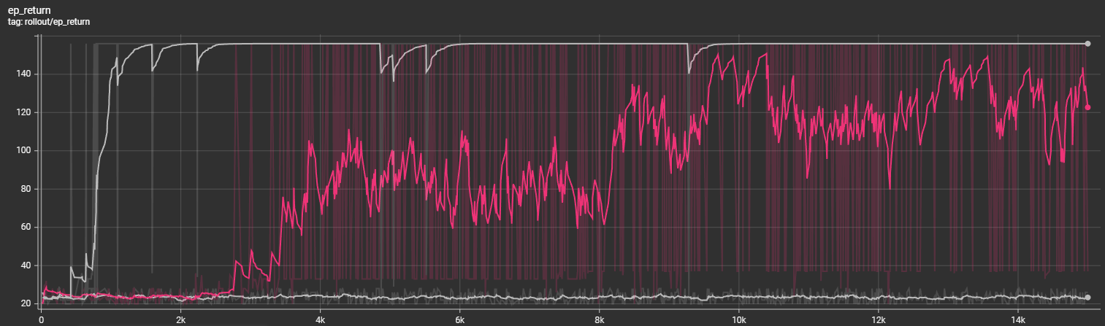
Train without Augmentation on different configurations
1
2
3
Two configurations: (30, 10), (28, 10)
Seven configurations: (30, 10), (28, 10), (32, 10), (26, 10), (34, 10), (30, 14), (28, 14)
Nine configurations: (30, 10), (28, 10), (32, 10), (26, 10), (34, 10), (30, 14), (28, 14), (32, 14), (26, 14)

Slide 2
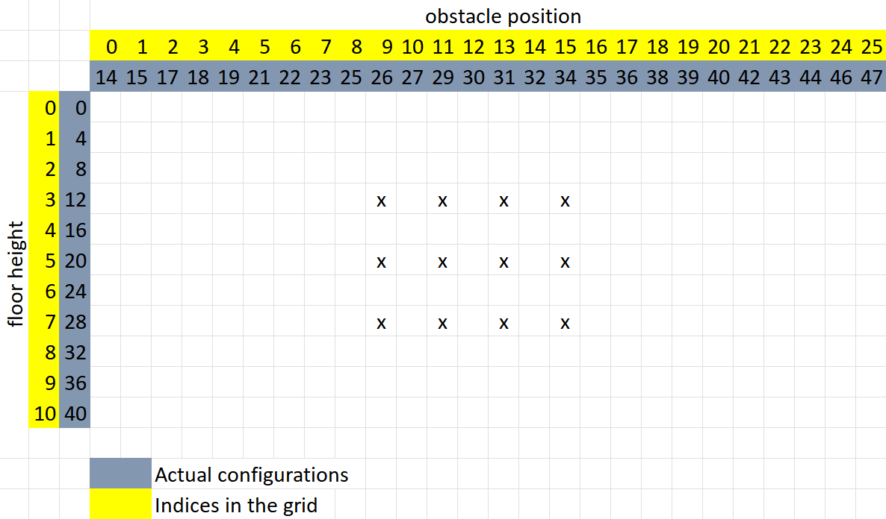
Narrow grid

Slide 3
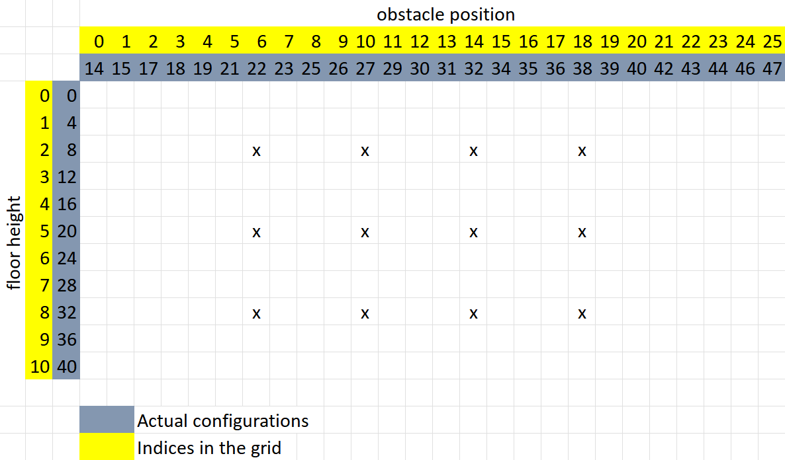
wide grid

Slide 4
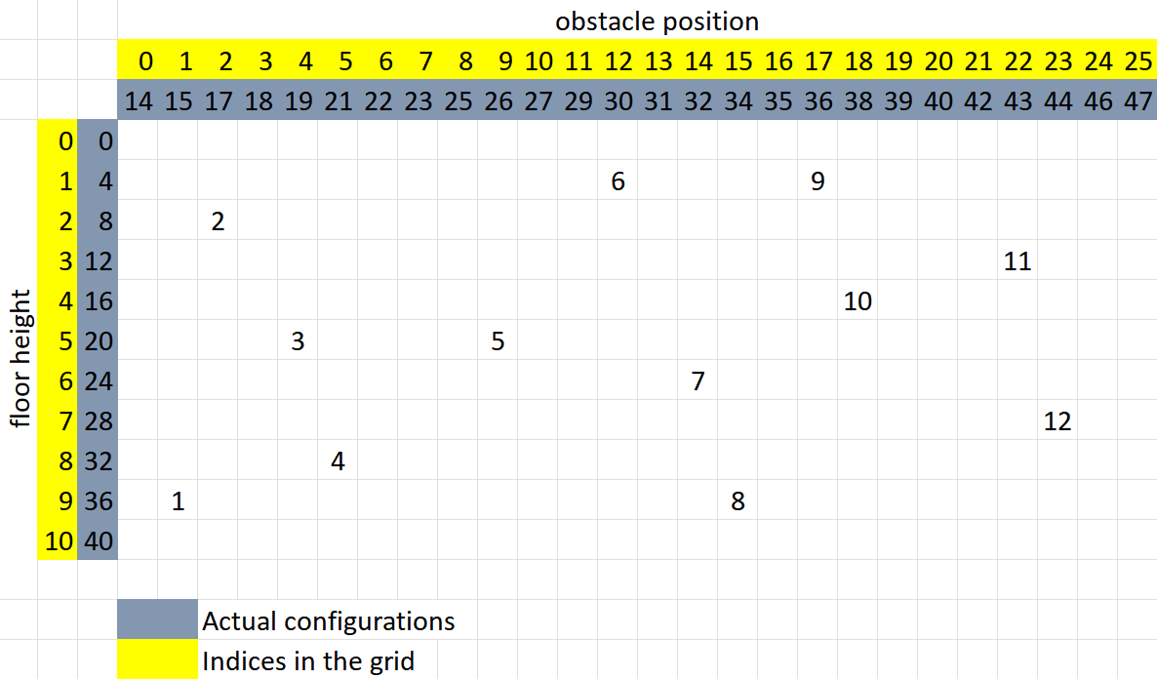
random grid

Slide 5
The following tests were done without any augmentation

Slide 6
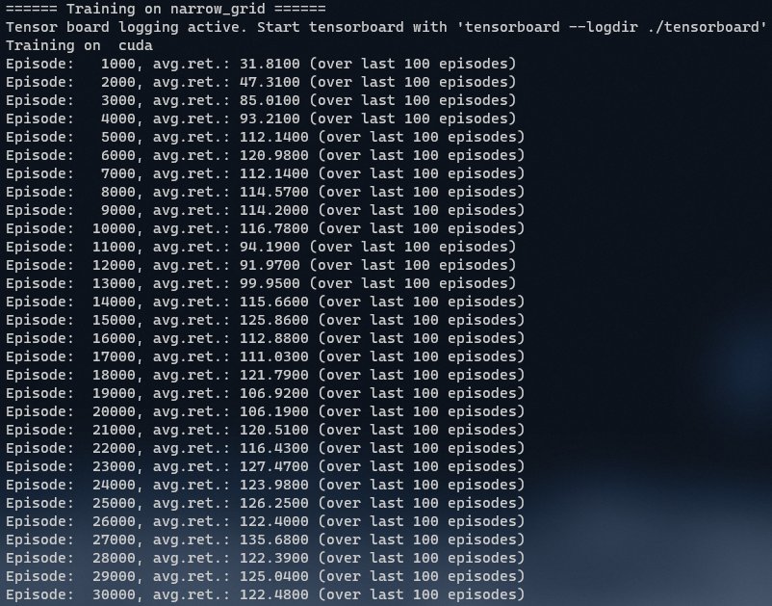
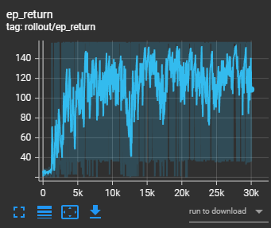
Smoothing 0.8

Slide 7
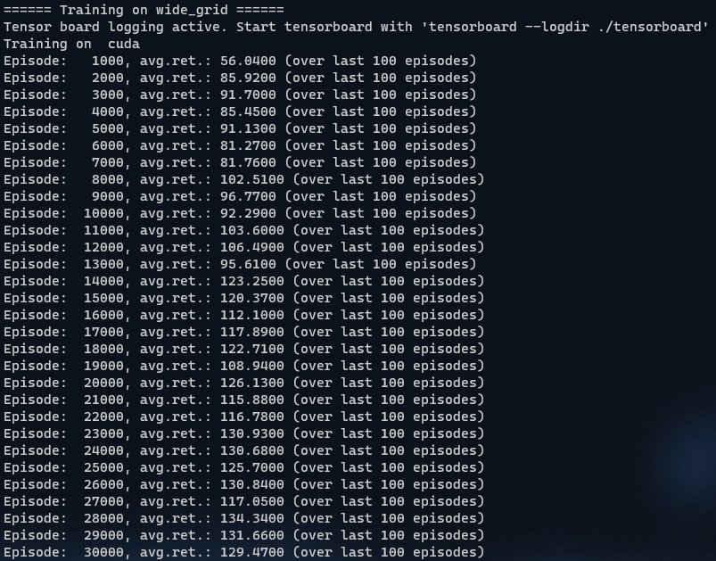
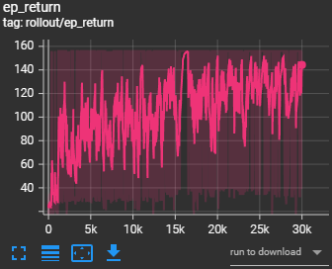
Smoothing 0.8

Slide 8
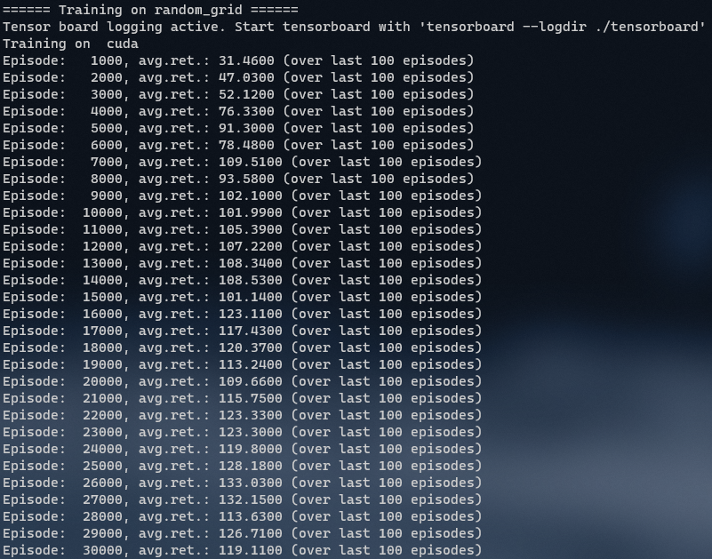
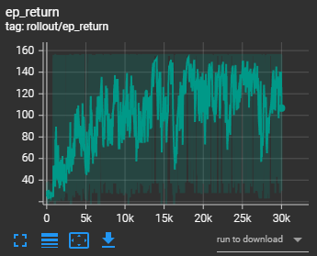
Smoothing 0.8

Slide 9
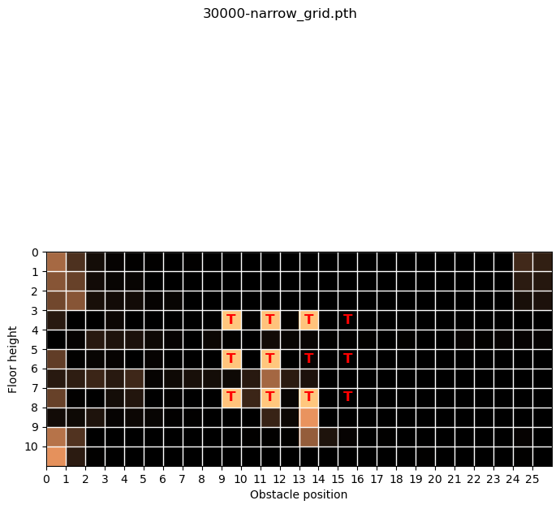

Slide 10
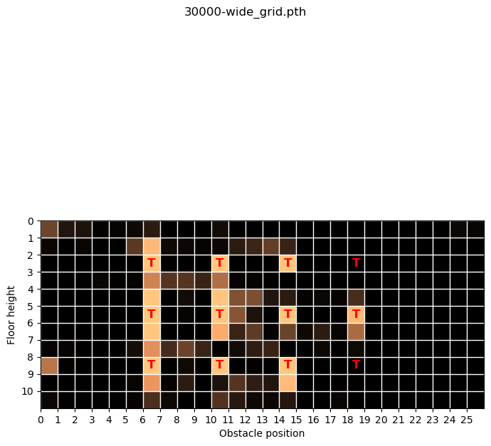

Slide 11
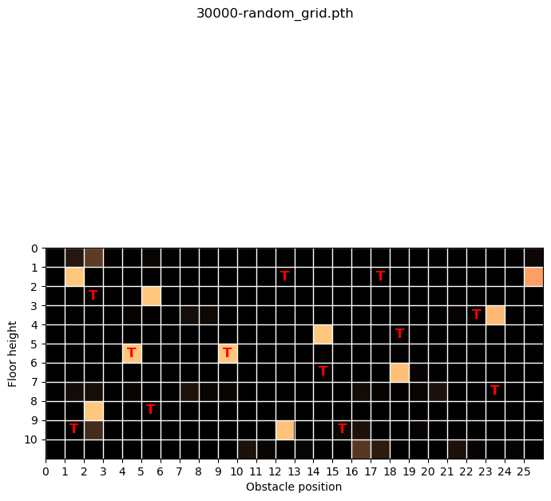

Slide 12
The following tests were done with random augmentation which changes at every step()

Slide 13
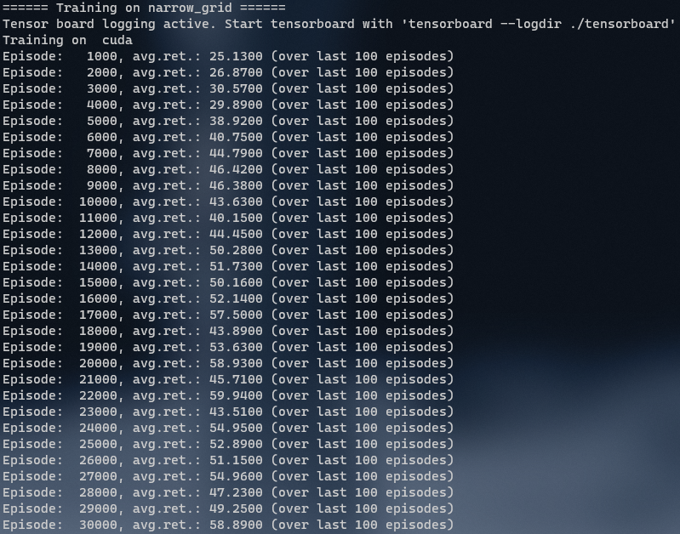
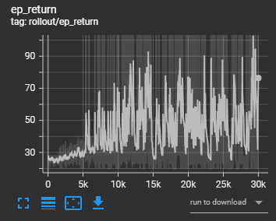
Smoothing 0.8

Slide 14
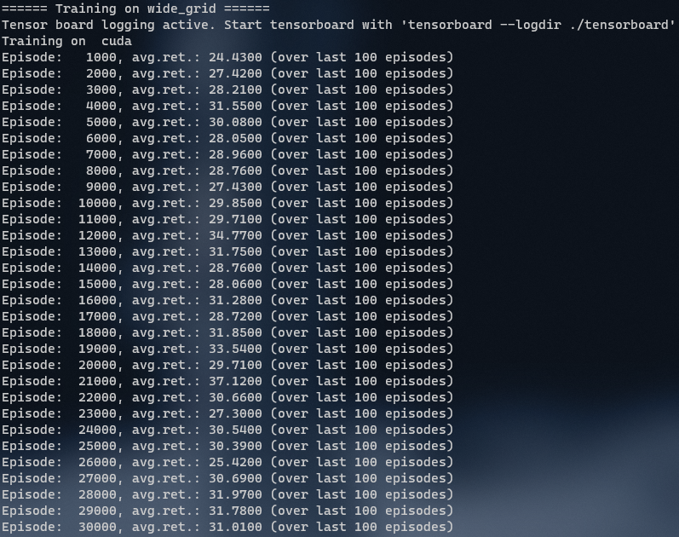
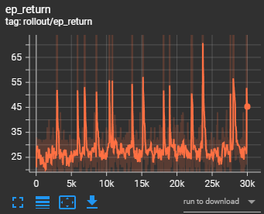
Smoothing 0.8

Slide 15
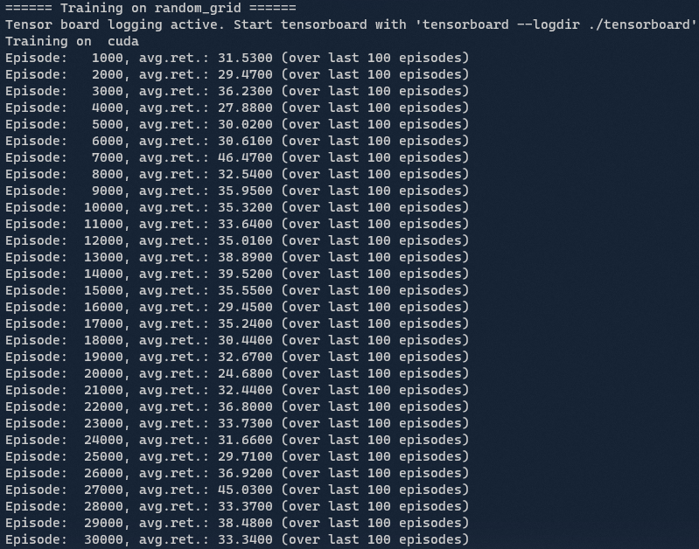
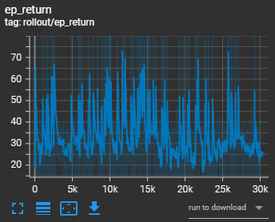
Smoothing 0.8

Slide 16
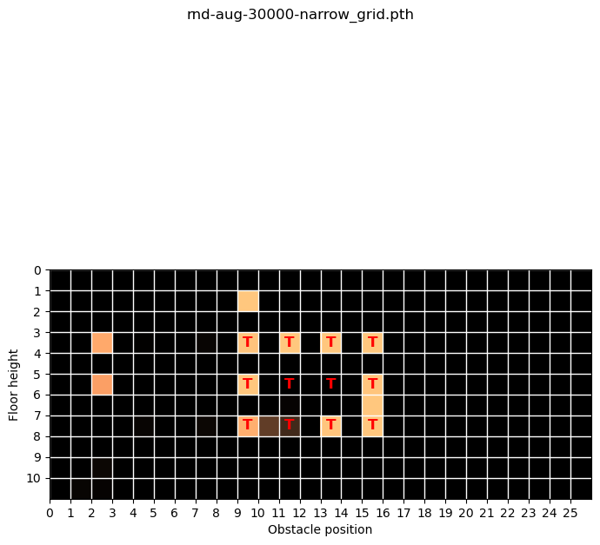

Slide 17
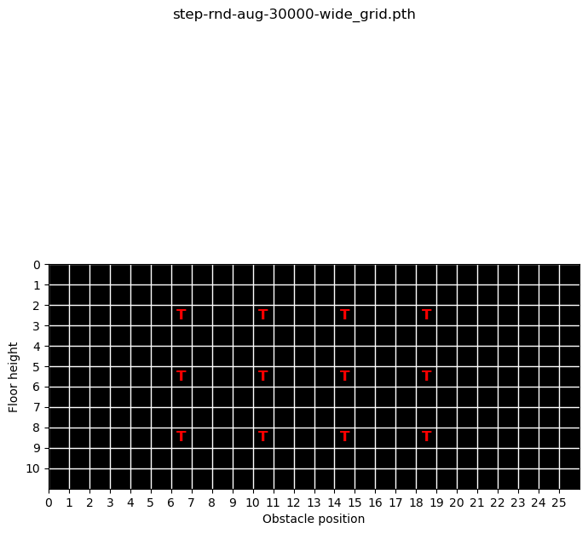

Slide 18
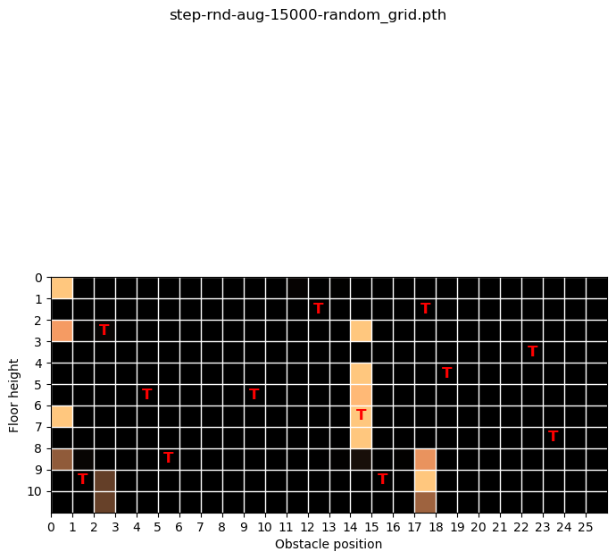

Slide 19
The following tests were done with random augmentation which changes every episode

Slide 20
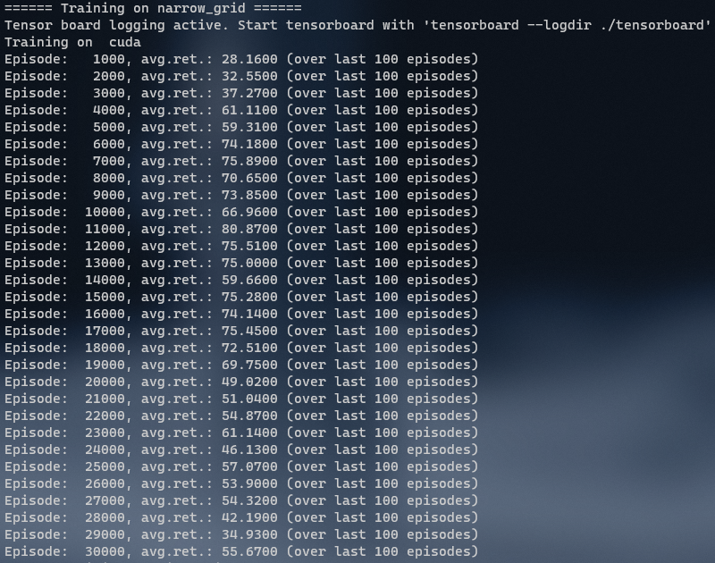
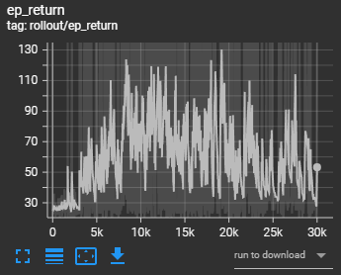
Smoothing 0.8

Slide 21
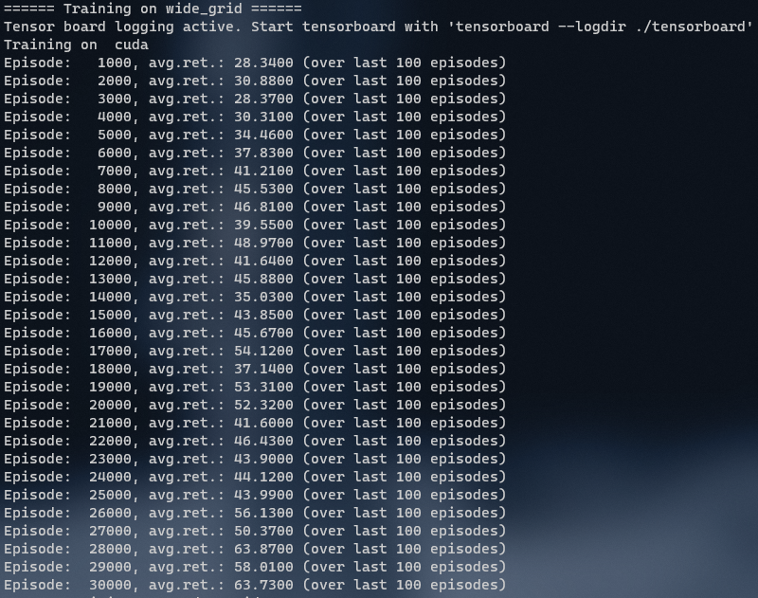
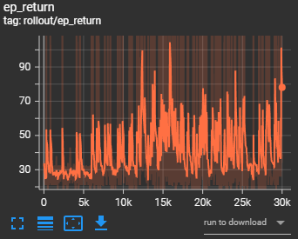
Smoothing 0.8

Slide 22
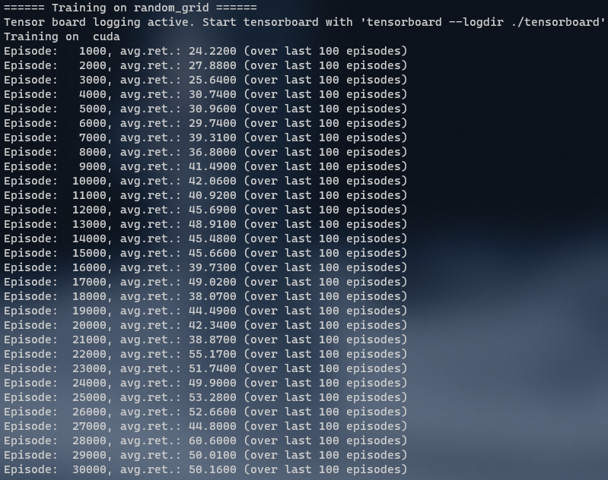
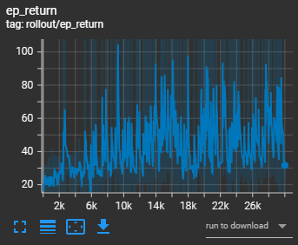
Smoothing 0.8

Slide 23
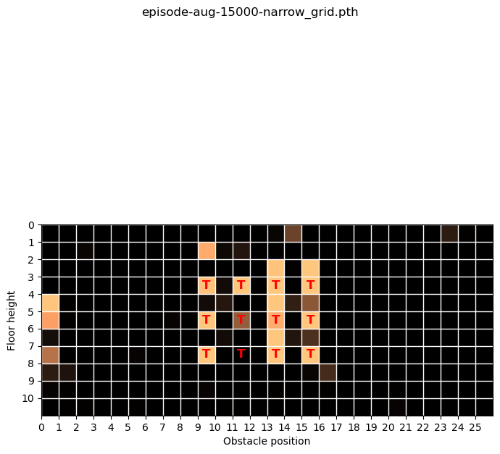

Slide 24
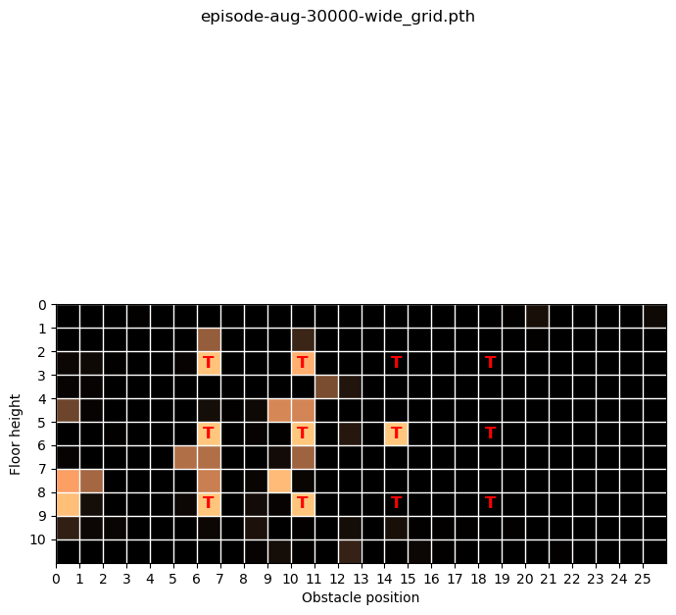

Slide 25
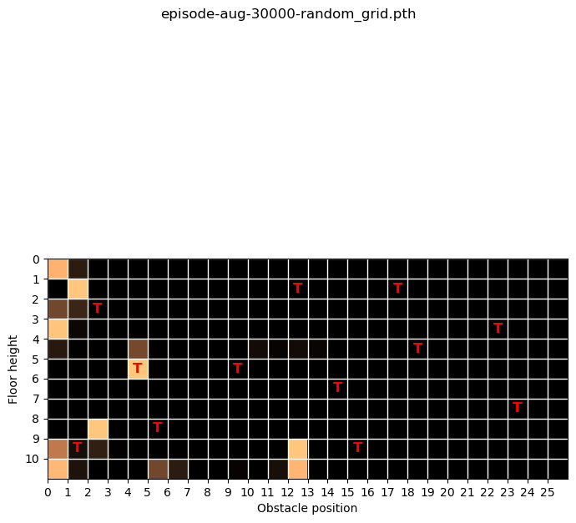

Slide 26
Questions
When to choose the augmentation? At every step? Or for every episode and keep the augmentation for the entire episode?
gym.vector.SyncVectorEnv for speed up?
Normalize observations before inserting them into the first layer or is Layer Norm enough? Where to place LayerNorm layer?
Stable baselines graph looks way smoother. What are possible reasons?
Do the steps in tensorborad logs of sb3 correspond to environment steps?

